Slide 1

50.039 Theory and Practice of Deep Learning W5-S1 Times Series Data and Recurrent Neural Networks
Matthieu De Mari

Slide 2
About this week (Week 5)
XXX

Slide 3
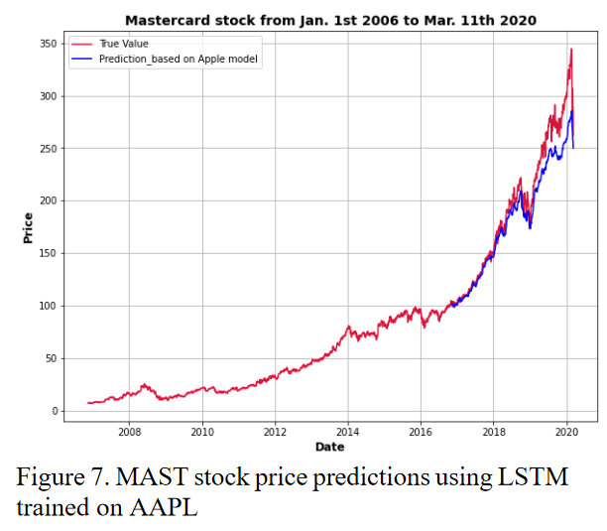
Time series dataset
Definition (time series dataset):
A time series dataset is a sequence of data points that are collected over time, typically at regular intervals.
Time series data can be used to study how a particular variable changes over time, with many applications as
Stock prices,
Weather patterns,
Etc.
Data points are usually ordered chronologically, with each data point representing the value of the variable at a specific point in time.

Slide 4
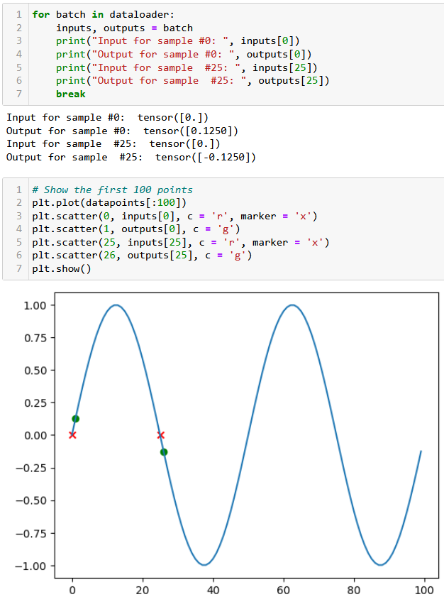
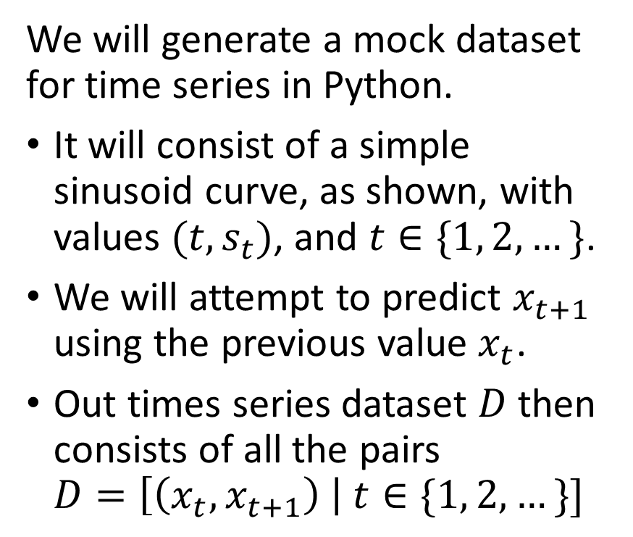
A mock dataset
We will generate a mock dataset for time series in Python.
It will consist of a simple sinusoid curve, as shown, with values $(t,s_{t})$, and $t∈\{1, 2,…\}$.
We will attempt to predict $x_{t+1}$ using the previous value $x_{t}$.
Out times series dataset $D$ then consists of all the pairs $D=\left[\left(x_{t}, x_{t+1}\right) \right| t∈\{1, 2, …\}]$

Slide 5
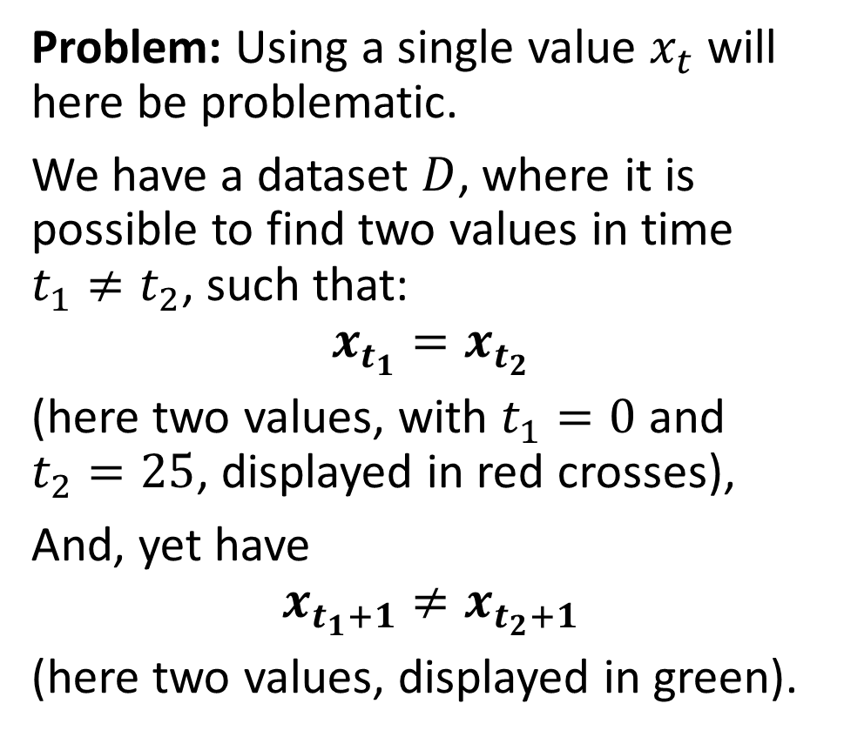
A mock dataset
Problem: Using a single value $x_{t}$ will here be problematic.
We have a dataset $D$, where it is possible to find two values in time $t_{1}≠t_{2}$, such that:
$$x_{t_{1}}=x_{t_{2}}$$ (here two values, with $t_{1}=0$ and $t_{2}=25$, displayed in red crosses),
And, yet have
$$x_{t_{1}+1}≠x_{t_{2}+1}$$
(here two values, displayed in green).

Slide 6
Typical methods for analysing a time series
Typical methods for analysing a time series include
Descriptive statistics: calculating basic summary statistics for the time series (mean, median, variance, etc.). These statistics can provide insights into the central tendency, variability, and distribution of the data.
Visual inspection: Plotting the time series data helps identify patterns, trends, and outliers in the data.

Slide 7
Typical methods for analysing a time series
Decomposition: Time series data often exhibit trends, seasonal patterns, and irregular fluctuations.
Decomposition is a method for separating these components and analysing them separately
Common methods for decomposition include additive and multiplicative decomposition.
(These are out-of-scope.)

Slide 8
A quick word about decomposition
Decomposition separates the time series data into different components that capture distinct aspects of the data, expressing it as the sum of several underlying components, each with its own distinct pattern, e.g.:
Trend: This component represents the long-term changes or fluctuations in the data over time. It is typically modelled as a smooth curve that captures the overall direction of the time series.
Seasonal: This component captures the regular, periodic fluctuations in the data that occur over fixed periods of time, such as daily, weekly, or monthly. It is often modelled as a set of repeating patterns that correspond to the seasonal cycles.
Residual: This component represents the random or irregular fluctuations in the data that are not explained by the trend or seasonal components. It is often modelled as a series of random noise or white noise.

Slide 9
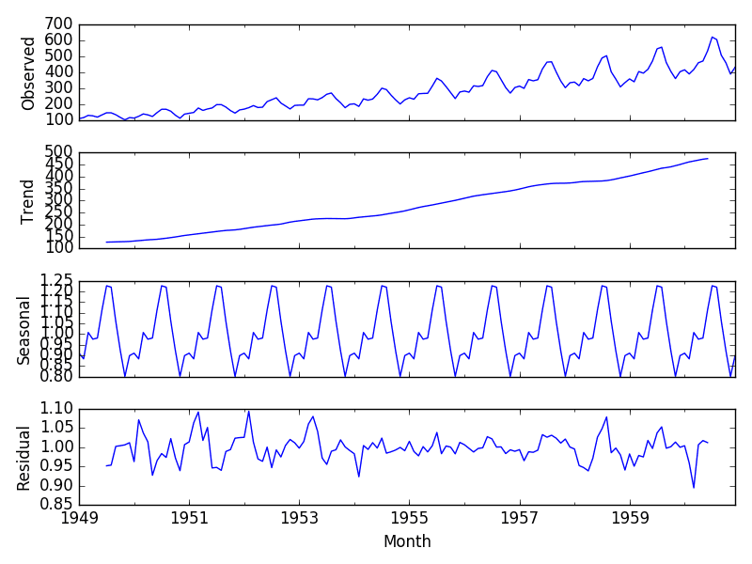
A quick word about decomposition
Decomposition separates a time series into trend (long-term changes), seasonal (periodic fluctuations), and residual (random fluctuations) components.
Trend is a smooth curve, seasonal is a set of repeating patterns, and residual is a series of random noise.

Slide 10
Typical methods for analysing a time series
Decomposition: Time series data often exhibit trends, seasonal patterns, and irregular fluctuations.
Decomposition is a method for separating these components and analysing them separately
Common methods for decomposition include additive and multiplicative decomposition.
(These are out-of-scope.)

Slide 11
Typical methods for analysing a time series
Time series models: Statistical models used to describe the underlying processes that generate the time series data.
Time series models can be used for forecasting future values, identifying important predictors, and understanding the relationships among variables.
ML models: autoregressive integrated moving average (ARIMA) models, exponential smoothing models, state space models, etc.
(These are out-of-scope.)

Slide 12
Typical methods for analysing a time series
Time series models: Statistical models used to describe the underlying processes that generate the time series data.
Time series models can be used for forecasting future values, identifying important predictors, and understanding the relationships among variables.
DL models: using neural networks as predictors, to predict the next value for a time series variable given a history as input.

Slide 13
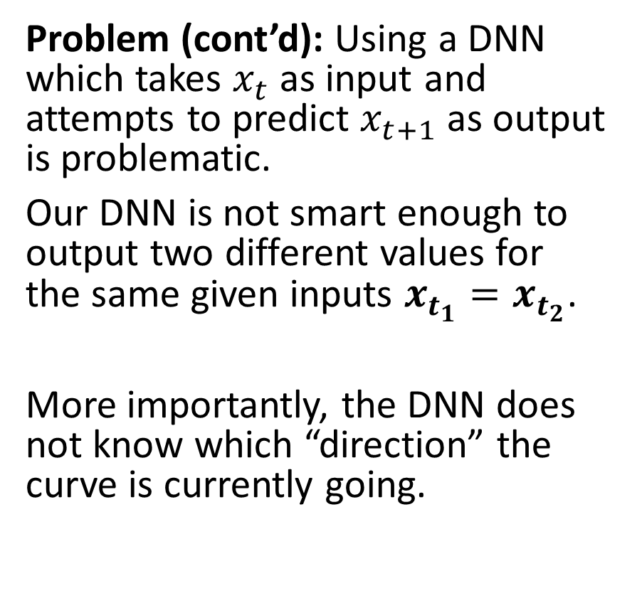
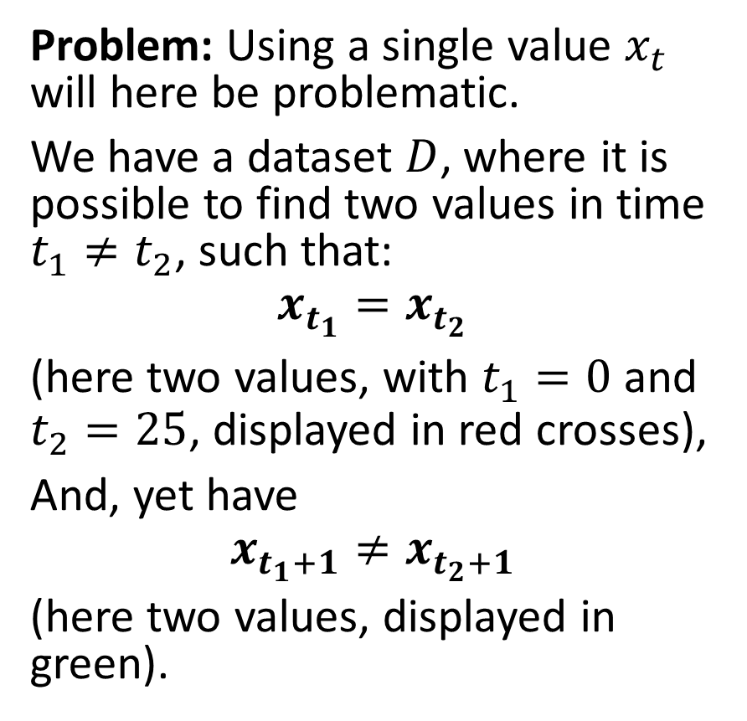
Using a simple DNN to predict
Problem: Using a single value $x_{t}$ will here be problematic.
We have a dataset $D$, where it is possible to find two values in time $t_{1}≠t_{2}$, such that:
$$x_{t_{1}}=x_{t_{2}}$$ (here two values, with $t_{1}=0$ and $t_{2}=25$, displayed in red crosses),
And, yet have
$$x_{t_{1}+1}≠x_{t_{2}+1}$$
(here two values, displayed in green).
Problem (cont’d): Using a DNN which takes $x_{t}$ as input and attempts to predict $x_{t+1}$ as output is problematic.
Our DNN is not smart enough to output two different values for the same given inputs $x_{t_{1}}=x_{t_{2}}$.
More importantly, the DNN does not know which “direction” the curve is currently going.

Slide 14
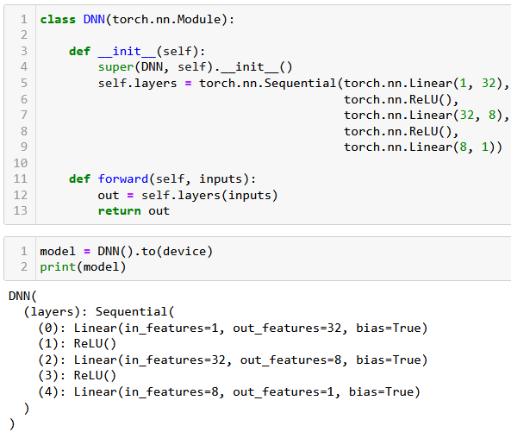
Using a simple DNN to predict
Let us try and define a simple DNN nonetheless:
3 Linear Layers + ReLU,
No ReLU on final layer,
Number of inputs = 1,
Number of outputs = 1,
Hidden layers sizes: 32 and 8.

Slide 15
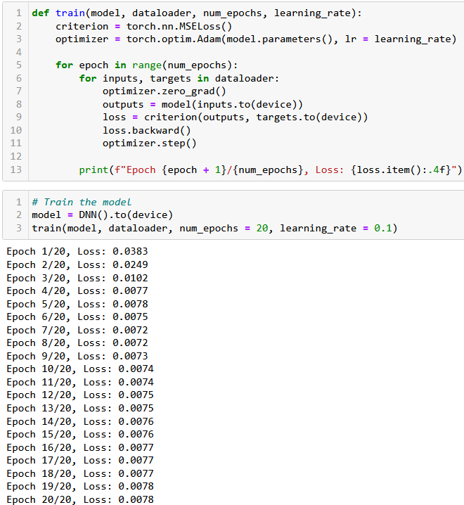
Using a simple DNN to predict
Let us try and define a simple DNN nonetheless:
3 Linear Layers + ReLU,
No ReLU on final layer,
Number of inputs = 1,
Number of outputs = 1,
Hidden layers sizes: 32 and 8.
Simple trainer function, and seems to train, but is it good?

Slide 16
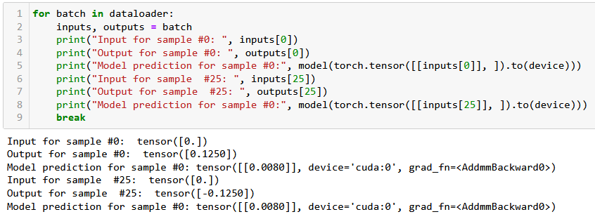

Using a simple DNN to predict
This low loss obtained after training does not mean much…
Thee model is not capable of learning to predict correctly: it is not smart enough to output two different values for the same given inputs $x_{t_{1}}=x_{t_{2}}$.
Also, it needs to know which “direction” the curve is currently going.

Slide 17
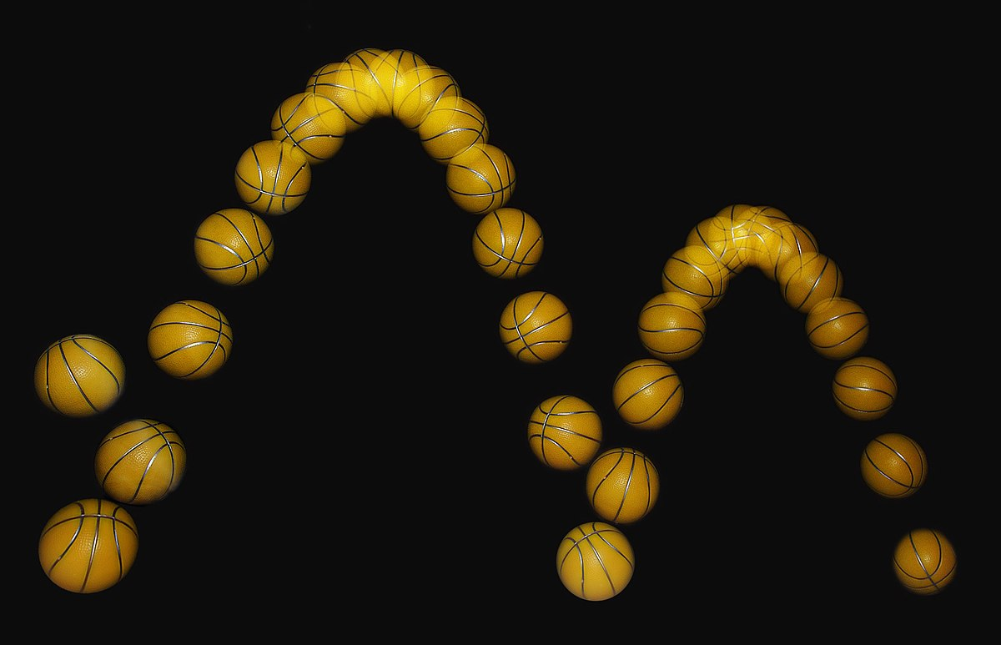
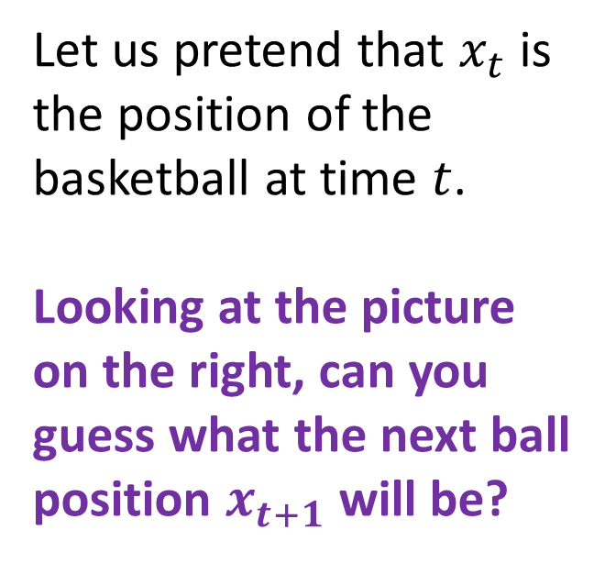
A visual example for the need of “direction”
Let us pretend that $x_{t}$ is the position of the basketball at time $t$.
Looking at the picture on the right, can you guess what the next ball position $x_{t+1}$ will be?
????

Slide 18
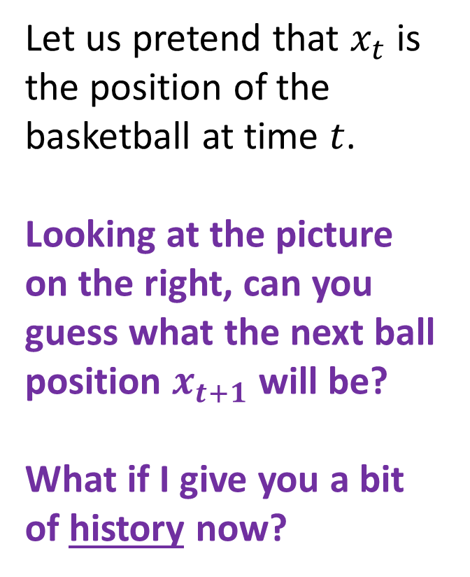
A visual example for the need of “direction”
Let us pretend that $x_{t}$ is the position of the basketball at time $t$.
Looking at the picture on the right, can you guess what the next ball position $x_{t+1}$ will be?
What if I give you a bit of history now?

Slide 19
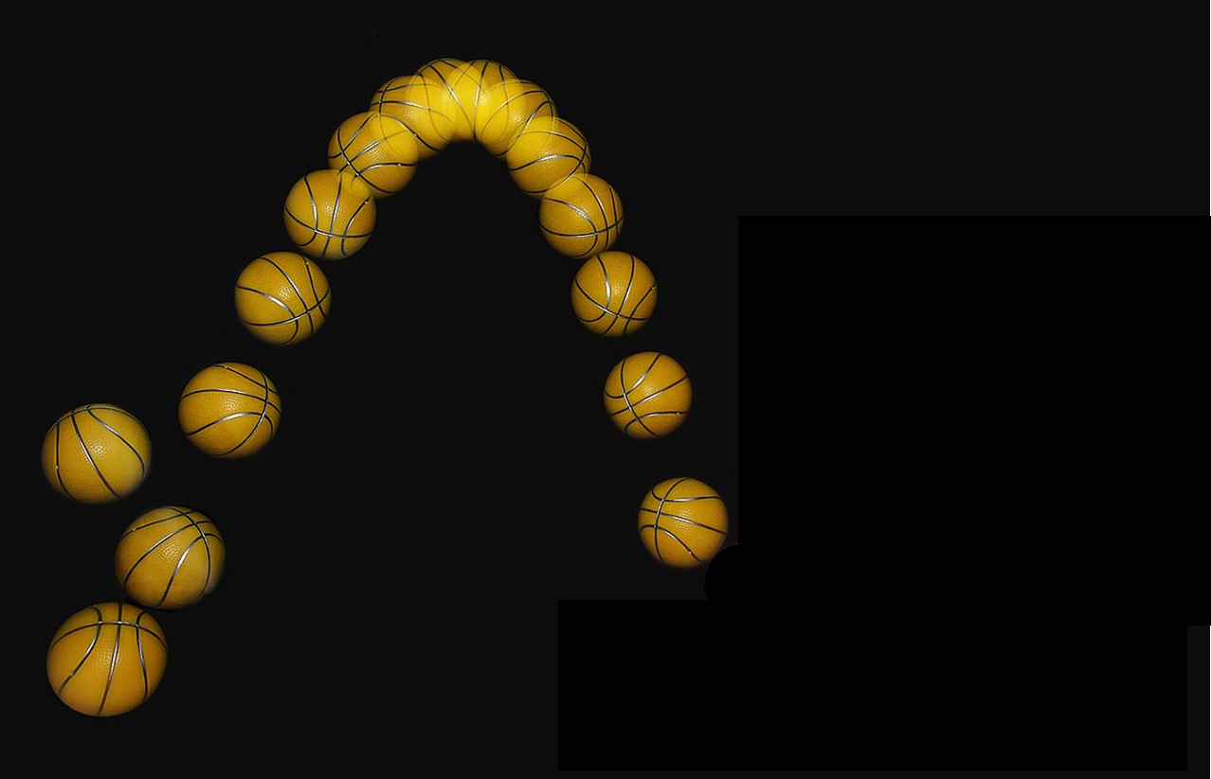
A visual example for the need of “direction”
Definition (history):
History refers to the past observations or values of the time series up to a certain point in time.
It provides information about the patterns and trends of the data over time, which can be used to make predictions and identify important factors that influence the time series.
E.g., predicting a stock price, requires to know the history of the stock prices, as past values of the stock prices can provide important information about the trend and volatility of the stock.

Slide 20
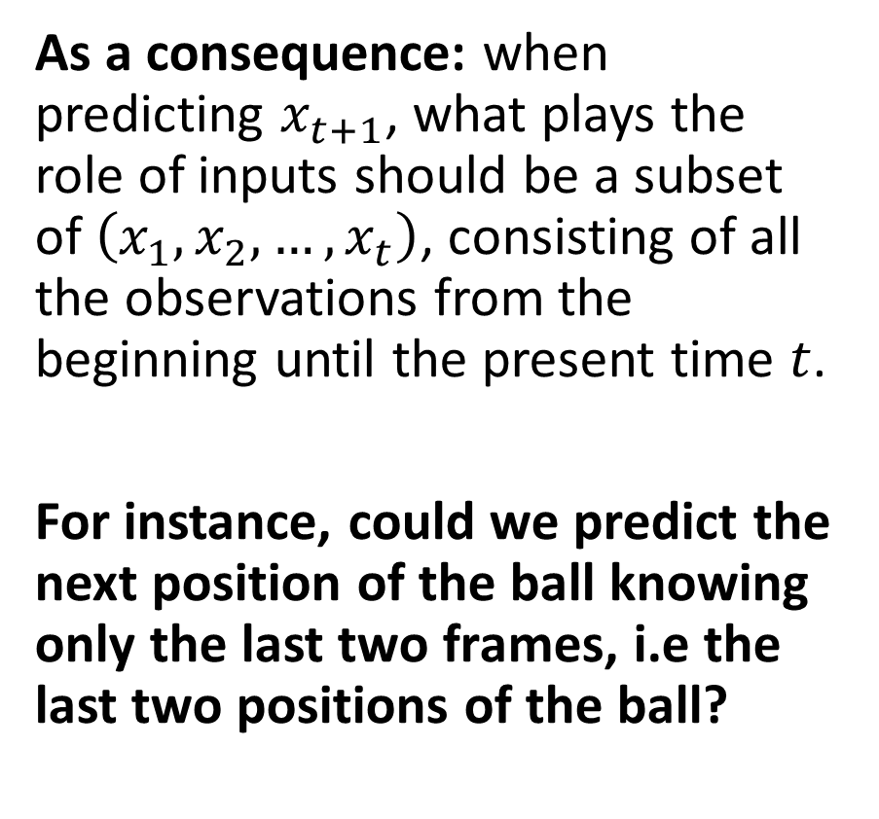
A visual example for the need of “direction”
As a consequence: when predicting $x_{t+1}$, what plays the role of inputs should be a subset of $\left(x_{1}, x_{2}, …, x_{t}\right)$, consisting of all the observations from the beginning until the present time $t$.
For instance, could we predict the next position of the ball knowing only the last two frames, i.e the last two positions of the ball?

Slide 21
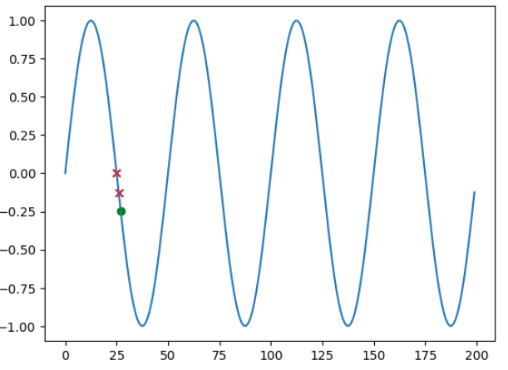
Reworking the Dataset a bit
Definition (lookback size):
The number of past observations or values of a time series that are used to make a prediction is commonly referred to as the "lookback" or "window" size.
It is the length of the history that is used to inform the prediction of the next value in the time series.
In our example, the lookback size is simply 2.

Slide 22
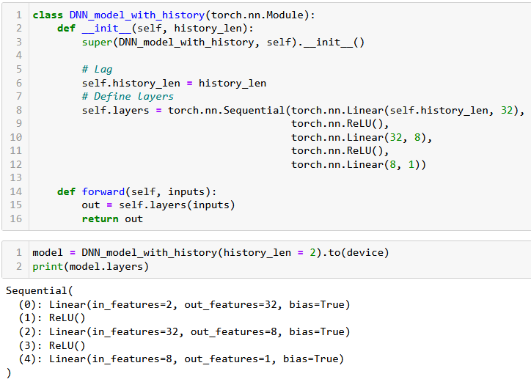
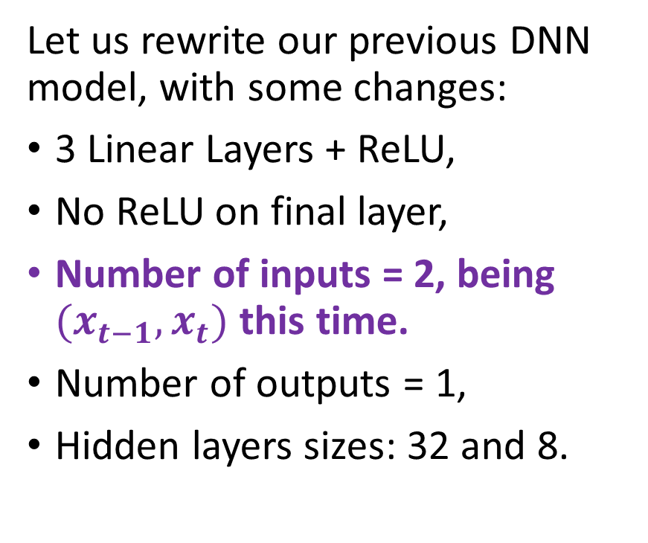
Using a simple DNN to predict
Let us rewrite our previous DNN model, with some changes:
3 Linear Layers + ReLU,
No ReLU on final layer,
Number of inputs = 2, being $(x_{t−1}, x_{t})$ this time.
Number of outputs = 1,
Hidden layers sizes: 32 and 8.

Slide 23
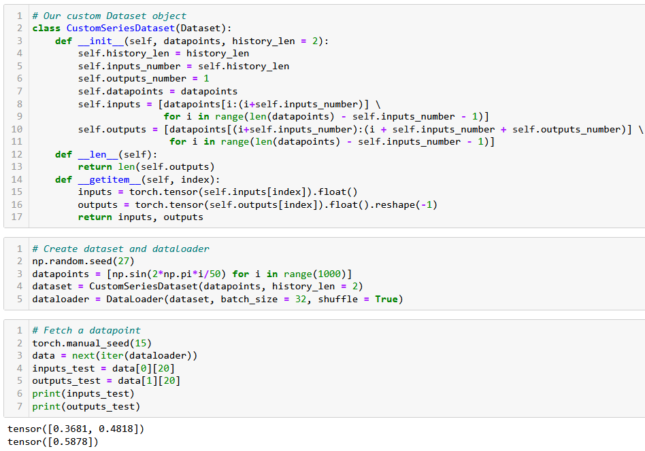
Reworking the Dataset to include history

Slide 24
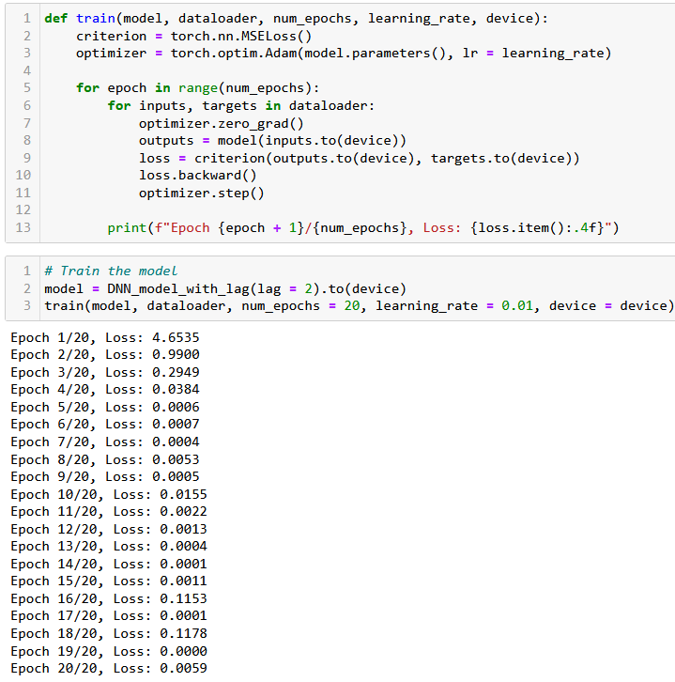
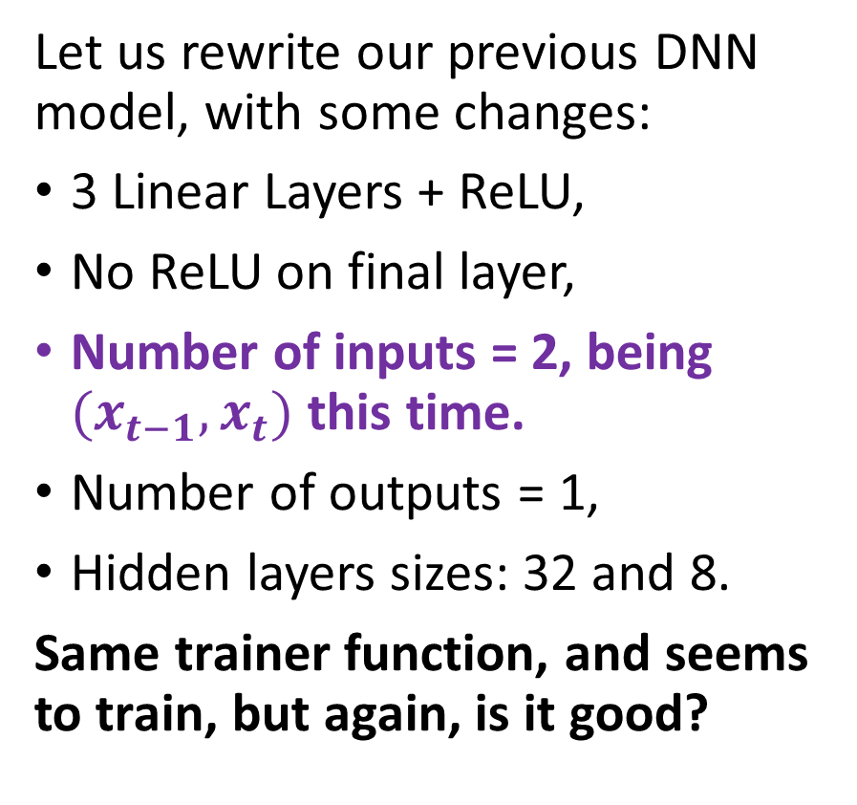
Using a simple DNN to predict
Let us rewrite our previous DNN model, with some changes:
3 Linear Layers + ReLU,
No ReLU on final layer,
Number of inputs = 2, being $(x_{t−1}, x_{t})$ this time.
Number of outputs = 1,
Hidden layers sizes: 32 and 8.
Same trainer function, and seems to train, but again, is it good?

Slide 25
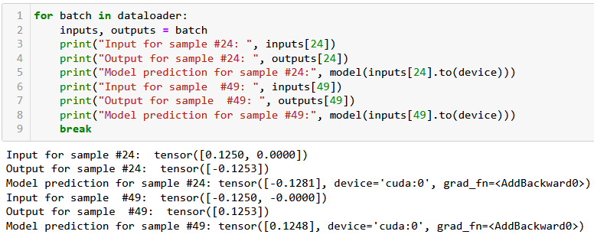

Using a simple DNN to predict
This time the predictor works, as we obtain the correct prediction values.
In the example below, we had $x_{t_{1}}=x_{t_{2}}$, but $x_{t_{1}−1}≠x_{t_{2}−1}$.
This was good enough to help the DNN formulate good predictions now.

Slide 26
The choice of history or lookback length in recurrent neural networks (RNNs) depends on the specific task and the nature of the data. Here are some general guidelines that can help you determine an appropriate lookback length:
Consider the time scale of the problem: The appropriate lookback length depends on the time scale of the problem you are trying to solve. For example, if you are trying to predict daily stock prices, you might use a lookback length of 30 days, while if you are trying to predict hourly traffic patterns, you might use a lookback length of 24 hours.
Look at the autocorrelation of the time series: The autocorrelation function (ACF) can provide information about the extent to which past values of the time series are correlated with future values. If the ACF decays rapidly, it suggests that the time series has short-term dependencies, and a smaller lookback length may be appropriate. If the ACF decays slowly, it suggests that the time series has long-term dependencies, and a larger lookback length may be necessary.
Use cross-validation to optimize the lookback length: Cross-validation can be used to determine the optimal lookback length for a given RNN architecture and task. This involves splitting the data into training and validation sets, and testing different lookback lengths to see which one performs best on the validation set.
Balance model complexity with overfitting: A larger lookback length can capture more of the historical patterns and trends in the data, but it can also increase the complexity of the model and lead to overfitting. A smaller lookback length may be simpler and less prone to overfitting, but it may also miss important patterns and trends in the data. Finding the optimal balance between model complexity and overfitting is a key consideration in choosing a lookback length.
In summary, the appropriate lookback length depends on the time scale of the problem, the autocorrelation of the time series, and the balance between model complexity and overfitting. Cross-validation can be used to optimize the lookback length for a given RNN architecture and task.

Slide 27
Variable history or lookback length can be a problem in recurrent neural networks (RNNs) because RNNs require fixed-length input sequences to work effectively. The input sequence to an RNN consists of a fixed number of time steps, and the network processes each time step sequentially, updating its internal state at each step.
If the history or lookback length varies, it can create inconsistencies in the input sequence, which can make it difficult for the RNN to learn a consistent representation of the time series data. In particular, if the input sequence is too short, the RNN may not have enough information to accurately model the time series data, while if the input sequence is too long, the RNN may become overburdened with irrelevant information.
In addition, variable history or lookback length can make it difficult to batch the input data, which is necessary for efficient training of the RNN. Batching involves grouping input sequences of the same length together and feeding them to the RNN simultaneously. If the input sequences have different lengths, they cannot be batched, and training the RNN can become inefficient.
There are several techniques that can be used to handle variable-length input sequences in RNNs, such as padding the input sequences with zeros to make them the same length, using masking to ignore irrelevant time steps, or using variable-length RNNs that can handle input sequences of different lengths. However, each of these techniques has its own limitations and trade-offs, and the choice of technique depends on the specific task and the nature of the data.

Slide 30
One way to implement memory in a recurrent neural network (RNN) is to use the concept of "embedding memory". Embedding memory involves representing past inputs as fixed-length vectors, or embeddings, that are stored in memory and used to inform future predictions.
Here is a high-level overview of how to implement embedding memory in an RNN:
Preprocess the input data: The first step is to preprocess the input data and convert it into a format that can be used by the RNN. This may involve encoding the data as numerical values, normalizing the data, or padding the data to ensure that all input sequences have the same length.
Define the embedding layer: The next step is to define an embedding layer that will be used to represent the past inputs as fixed-length vectors. The embedding layer is typically a simple neural network layer that maps the input data to a lower-dimensional space. The output of the embedding layer is a fixed-length vector that represents the input sequence.
Update the memory: At each time step, the input data is passed through the RNN, and the output of the RNN is combined with the previous embeddings to update the memory. The simplest way to update the memory is to concatenate the output of the RNN with the previous embeddings to create a new embedding that represents the current input sequence and the past information.
Use the memory to inform predictions: Once the memory has been updated, it can be used to inform future predictions. This typically involves concatenating the current input data with the current embedding, and passing the concatenated vector through a final neural network layer to make the prediction.

Slide 31
The vanishing gradient problem is a common issue that can occur in recurrent neural networks (RNNs) during training. The problem arises when the gradients used to update the weights of the RNN become very small, making it difficult to propagate information over long time lags.
In RNNs, each hidden state is computed as a function of the previous hidden state and the current input. During training, the error signal is backpropagated through time to adjust the weights of the network. However, this backpropagation can result in very small gradients for the earlier time steps, since the gradients are multiplied by the Jacobian matrix of the recurrent connection at each time step.
When the gradients become very small, the weights of the network are updated very slowly, which can lead to slow convergence or even stagnation in the learning process. This can be particularly problematic for RNNs, since they are designed to handle time series data that can exhibit long-term dependencies.
The vanishing gradient problem can be particularly severe in RNNs that use activation functions that saturate, such as the hyperbolic tangent (tanh) or sigmoid functions. When the activation function saturates, the gradients become very small, making it difficult to propagate information through the network.
Several techniques have been developed to address the vanishing gradient problem in RNNs, such as using alternative activation functions, initializing the weights of the network carefully, or using specialized architectures like Long Short-Term Memory (LSTM) networks or Gated Recurrent Units (GRUs) that are designed to better handle long-term dependencies. These techniques can help to mitigate the vanishing gradient problem and improve the performance of RNNs on time series data.

Slide 32
Both Gated Recurrent Units (GRUs) and Long Short-Term Memory (LSTM) networks are advanced versions of the basic Recurrent Neural Network (RNN) architecture, designed to better handle long-term dependencies in time series data.
In contrast, GRUs use gating mechanisms to selectively update and discard information in the hidden state, which can help to maintain the gradients and avoid the vanishing gradient problem. This makes them better suited for modeling complex time series data that exhibit long-term dependencies or nonlinear patterns.
In summary, the benefits of using GRUs over a simple RNN architecture include better handling of long-term dependencies, avoidance of the vanishing gradient problem, and improved accuracy in time series prediction.

Slide 33
While both LSTM and GRU networks are effective at capturing long-term dependencies in time series data, there are some benefits to using LSTMs over GRUs in certain scenarios:
LSTMs are better suited for tasks that require long-term memory retention. LSTMs are designed to maintain and propagate information over longer time lags than GRUs. This makes them better suited for tasks that require the network to retain information for longer periods of time, such as language modeling or speech recognition.
LSTMs are more expressive and can model more complex functions than GRUs. LSTMs have more parameters than GRUs, which can make them more expressive and better able to model complex nonlinear functions. This can be beneficial in tasks that require a high level of accuracy, such as image or speech recognition.
LSTMs can handle variable-length input sequences more effectively. LSTMs can handle input sequences of variable lengths more effectively than GRUs, as they have an explicit memory cell that can store information over multiple timesteps. This can be useful in applications where the length of the input sequence may vary, such as natural language processing.

Slide 34
A sequence-to-sequence (seq2seq) model is a type of neural network architecture that is commonly used for tasks that involve processing variable-length input sequences and generating variable-length output sequences. Seq2seq models typically consist of two parts: an encoder that processes the input sequence and generates a fixed-length context vector, and a decoder that uses the context vector to generate the output sequence.
Seq2seq models are widely used in natural language processing tasks such as machine translation, text summarization, and conversational agents. Here are some examples of seq2seq models in NLP:
Machine translation: Seq2seq models are commonly used for machine translation tasks, where the input is a sequence of words in one language and the output is a sequence of words in another language. The encoder processes the input sequence of words and generates a context vector, which is then used by the decoder to generate the output sequence of words in the target language.
Text summarization: Seq2seq models can be used for text summarization tasks, where the input is a long document and the output is a summary of the document. The encoder processes the input document and generates a context vector, which is then used by the decoder to generate the summary.
Conversational agents: Seq2seq models can be used to build conversational agents, where the input is a sequence of messages from a user and the output is a sequence of responses from the agent. The encoder processes the input sequence of messages and generates a context vector, which is then used by the decoder to generate the response.
Speech recognition: Seq2seq models can also be used for speech recognition tasks, where the input is a sequence of audio samples and the output is a sequence of words. The encoder processes the audio samples and generates a context vector, which is then used by the decoder to generate the words.
Overall, seq2seq models have proven to be a powerful and flexible architecture for a wide range of natural language processing tasks, where the input and output sequences can have variable lengths and complex structures.

Slide 35
Conclusion (Week 5)
XXX
XXX

Slide 36
Learn more about these topics
Out of class, supporting papers, for those of you who are curious.
[XXX] XXX

Slide 37
Learn more about these topics
Tracking important names (Track their works and follow them on Scholar, Twitter, or whatever works for you!)
XX XX: XX at XX.

Slide 38
Learn more about these topics
Some extra (easy) reading and videos for those of you who are curious.
[XXX] XXX

